Slide 1
Remote E- Proctoring System
Project Guide :
Mr. K. Kajendran Associate Professor
Team-D14
Mohan Vamsi A(211417104150)
Niteesh B(211417104169) Sai Ashwin D(211417104229)
Project coordinator:
Dr.N.Pughazendi Professor

Slide 2
Abstract
The project aims to provide a safe and user-friendly environment to take exams online to various locations for those who don't have access to campus.
The project employs various machine learning models to reduce the burden on the admin to detect malpractice by the students on a large scale.
The system includes five basic components that continuously estimate the key behaviour cues: user verification, audio processing, gaze detection, number of person detection, object and phone detection.
By combining the continuous estimation components, and applying a temporal sliding window, we design higher-level features to classify whether the test taker is cheating at any moment during the exam.

Slide 3
Technology Stack
Back-end
Front-end
Python
Tensor Flow Framework
OpenCV
Dlib
Speech_recognition
PyAudio
NLTK
Firebase/AWS
React
HTML/CSS
JavaScript

Slide 4
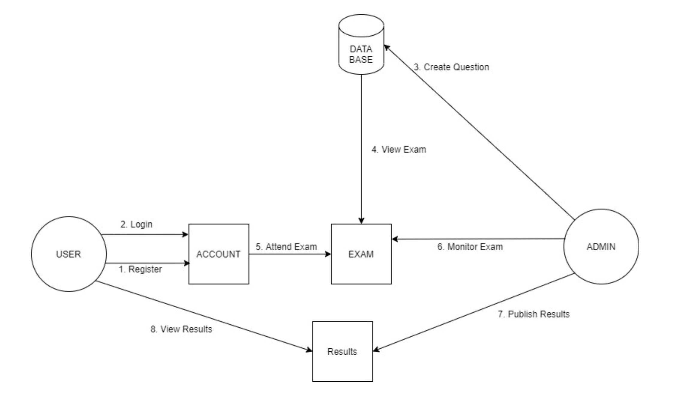
System Architecture

Slide 5
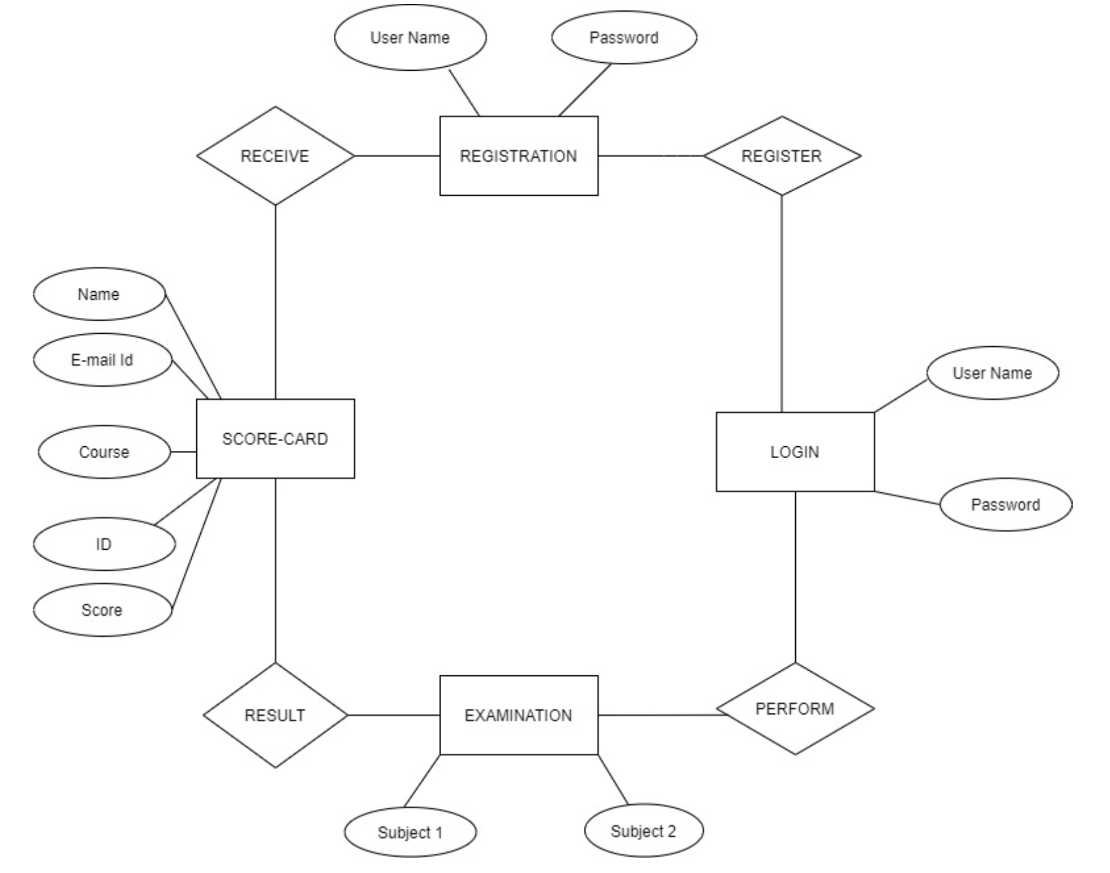
ER Diagram

Slide 6
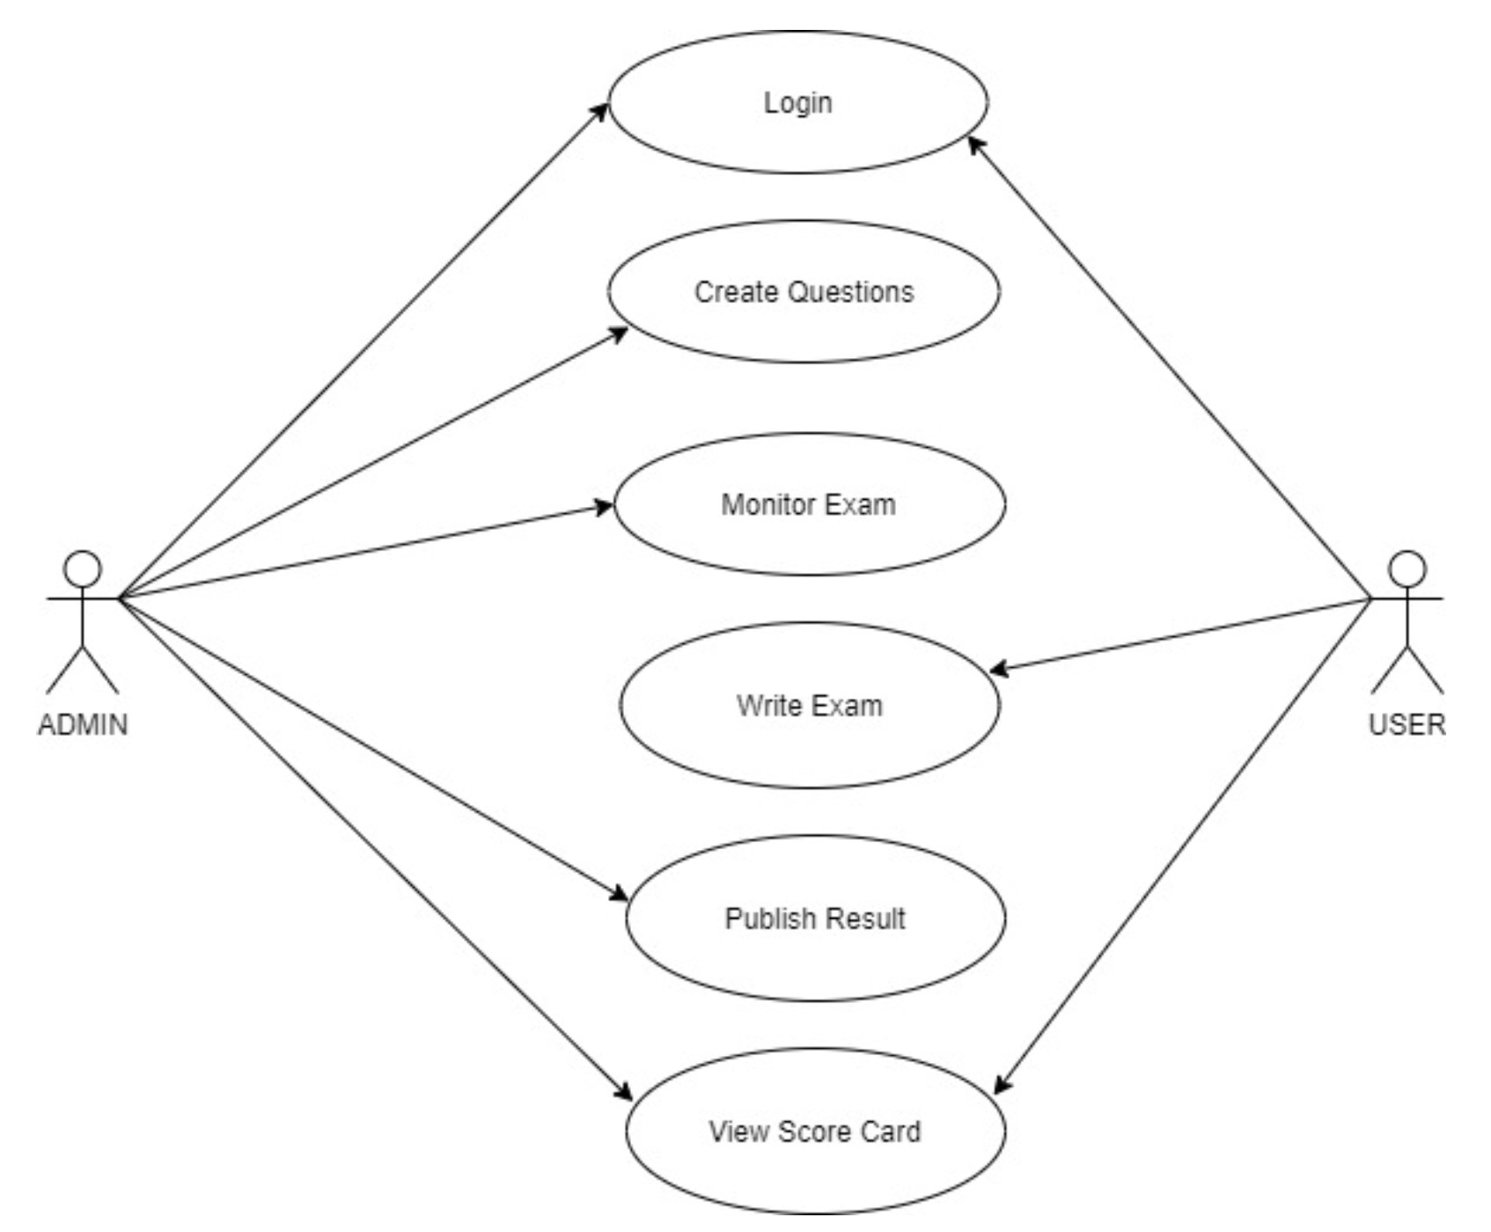
Use Case Diagram

Slide 7
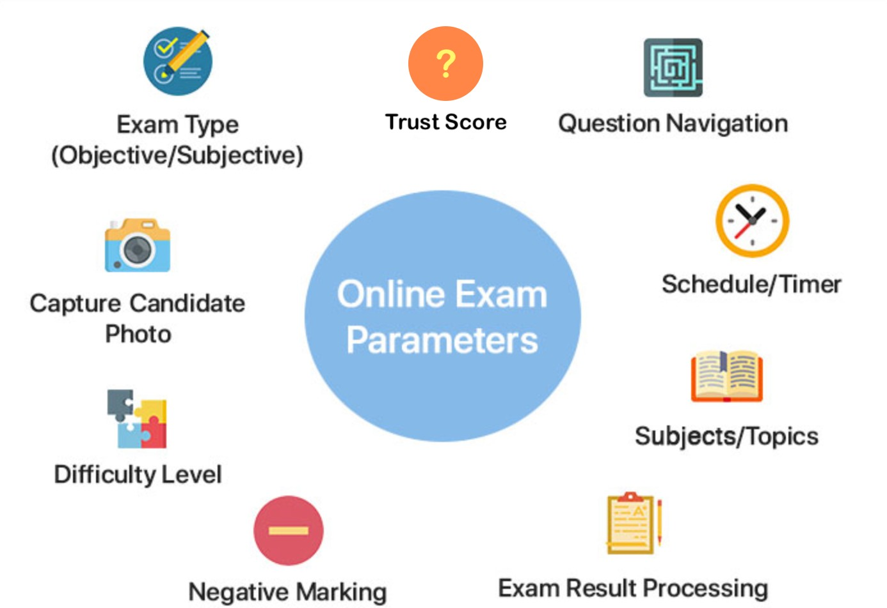

Slide 8
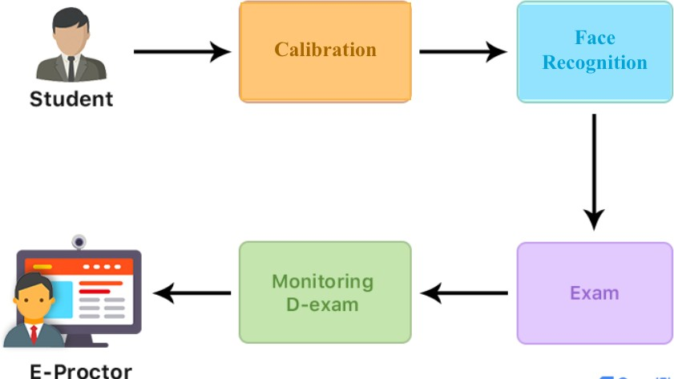

Slide 9
Module Description
Front-end module
Gaze recognition
Mouth positioning
Person count
Mobile detection
Face recognition
Audio recognition

Slide 10
1. Gaze recognition module- Aim to track the eyeballs of the test-taker and report if he is looking to the left, right, or up which he might do to have a glance at a notebook or signal to someone. This can be done using Dlib’s facial keypoint detector and OpenCV for further image processing.
Mouth positioning module- Dlib’s facial keypoints are again used for this task and the test-taker is required to sit straight and the distance between the lips keypoints is noted for 100 frames and averaged. If the user opens his/ her mouth the distances between the points increases and if the increase in distance is more than a certain value for at least three outer pairs and two inner pairs then infringement is reported.
Person Count and Mobile detection- The pre-trained weights of YOLOv3 trained on the COCO dataset to detect people and mobile phones in the webcam feed.

Slide 11
4. Face recognition- OpenCV face_recognition model in python is used to implement the module. The module OpenCV (Open source computer vision) is a library of programming functions mainly aimed at real-time computer vision.
5. Audio recognition- The idea is to record audio from the microphone and convert it to text using Google’s speech recognition API. The API needs a continuous voice from the microphone which is not plausible so the audio is recorded in chunks such there is no compulsory space requirement in using this method.

Slide 12
Functionalities
In this module the remote proctoring services include advanced features such as automated ID verification and authentication, real-time monitoring, content protection, a secure browser, computer lockdown settings, administrative controls and data analytics.
Automated proctoring involves the use of software to detect any form of fraudulent activity.
It can identify if another person is present in the room, the candidate is using a tool or software in the background and to verify the noise for the provided keywords.
Here, A trust score is introduced which defles the candidates’ integrity.
If any suspicious behaviour is found out, an alert is sent to the proctor, who will review it and make a decision.

Slide 13
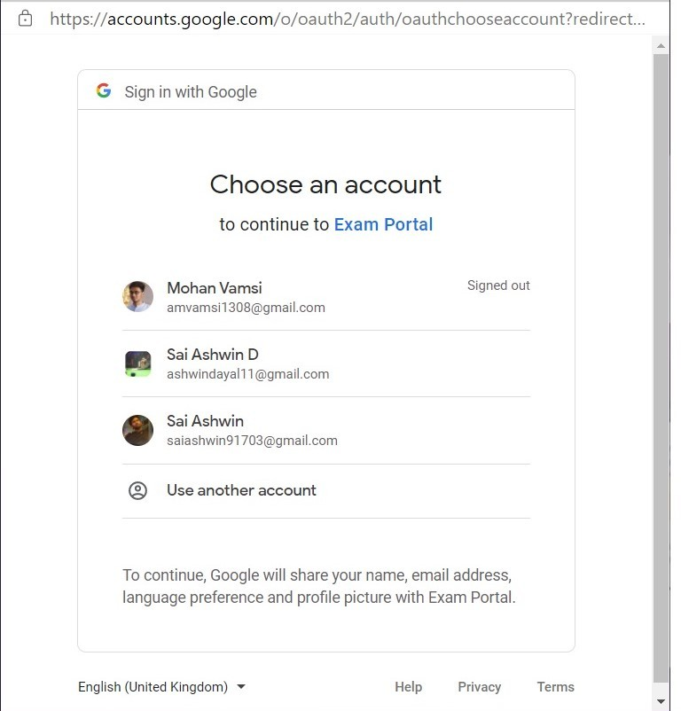
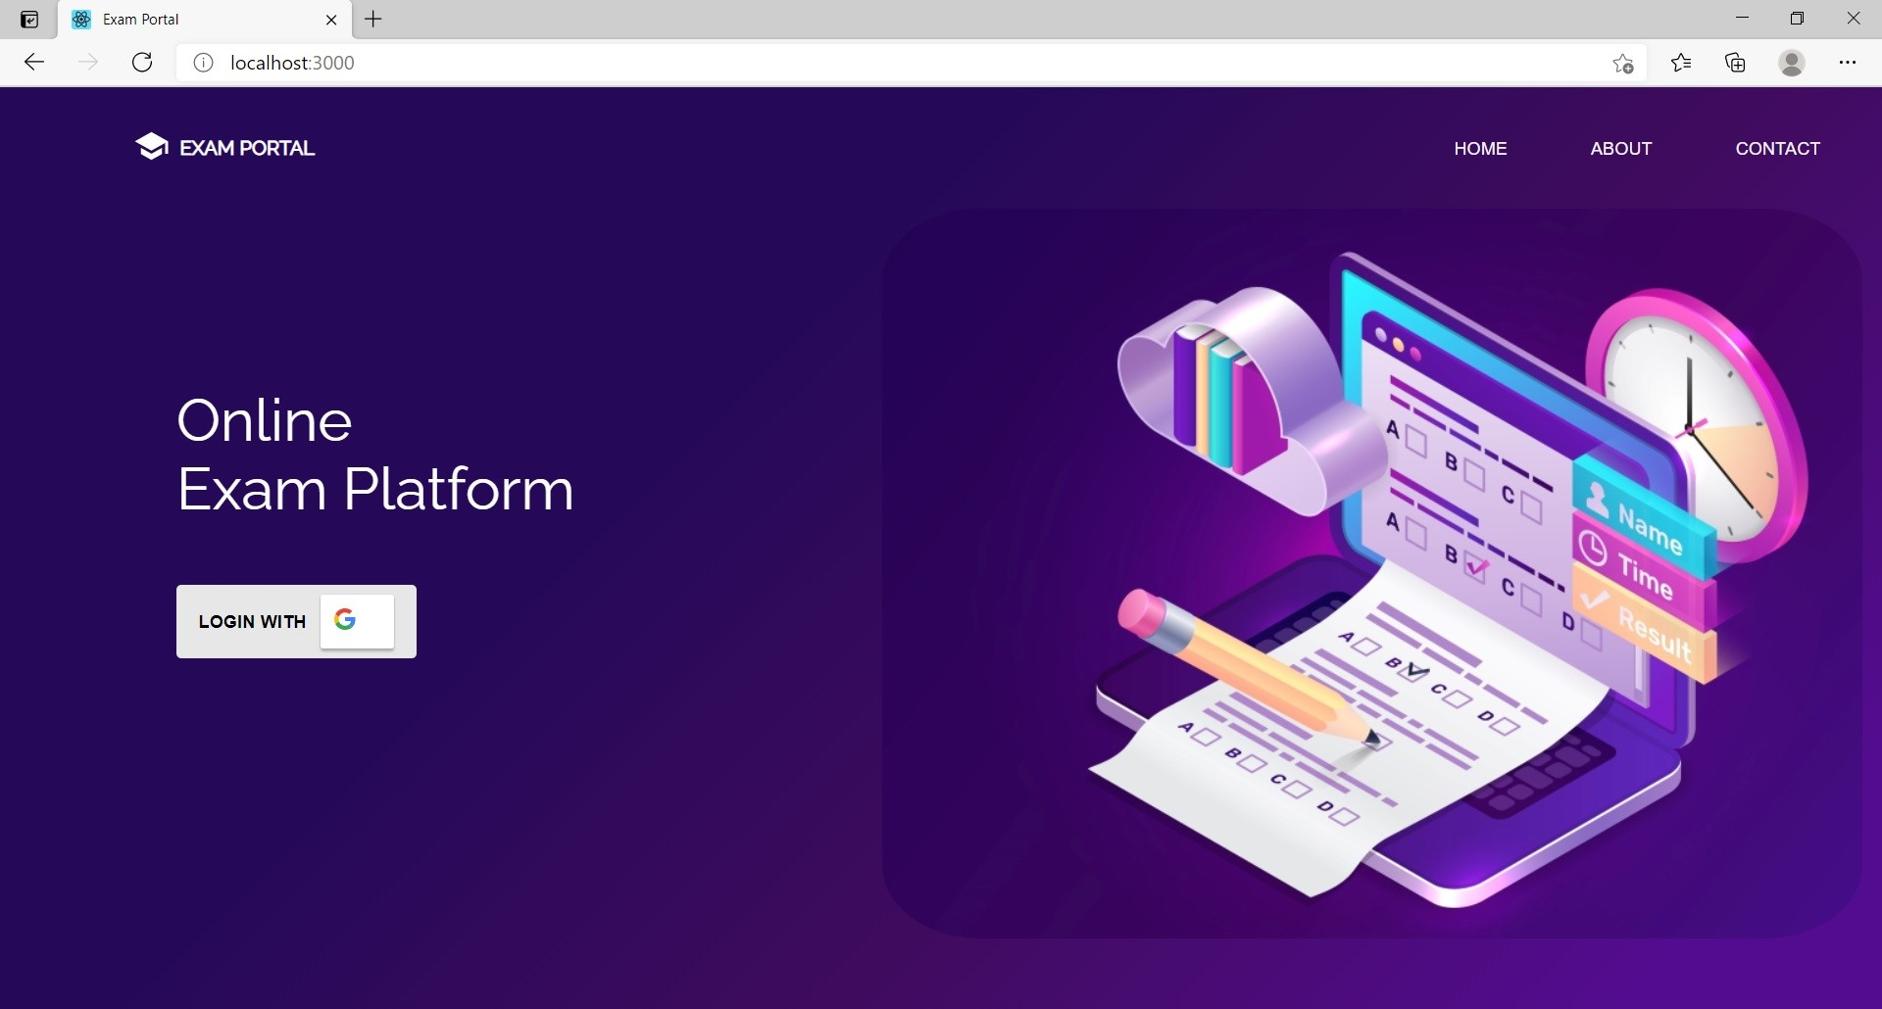
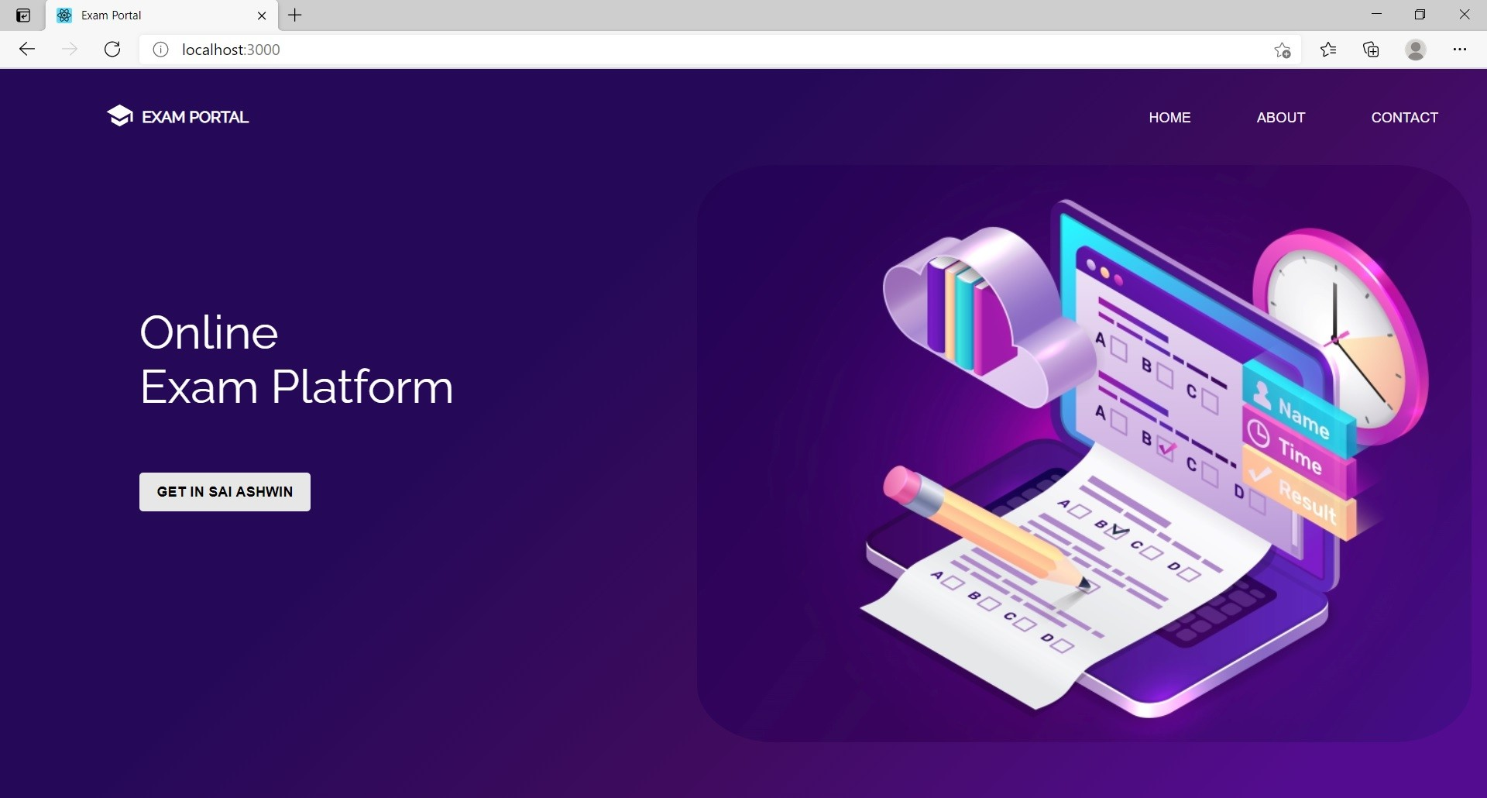
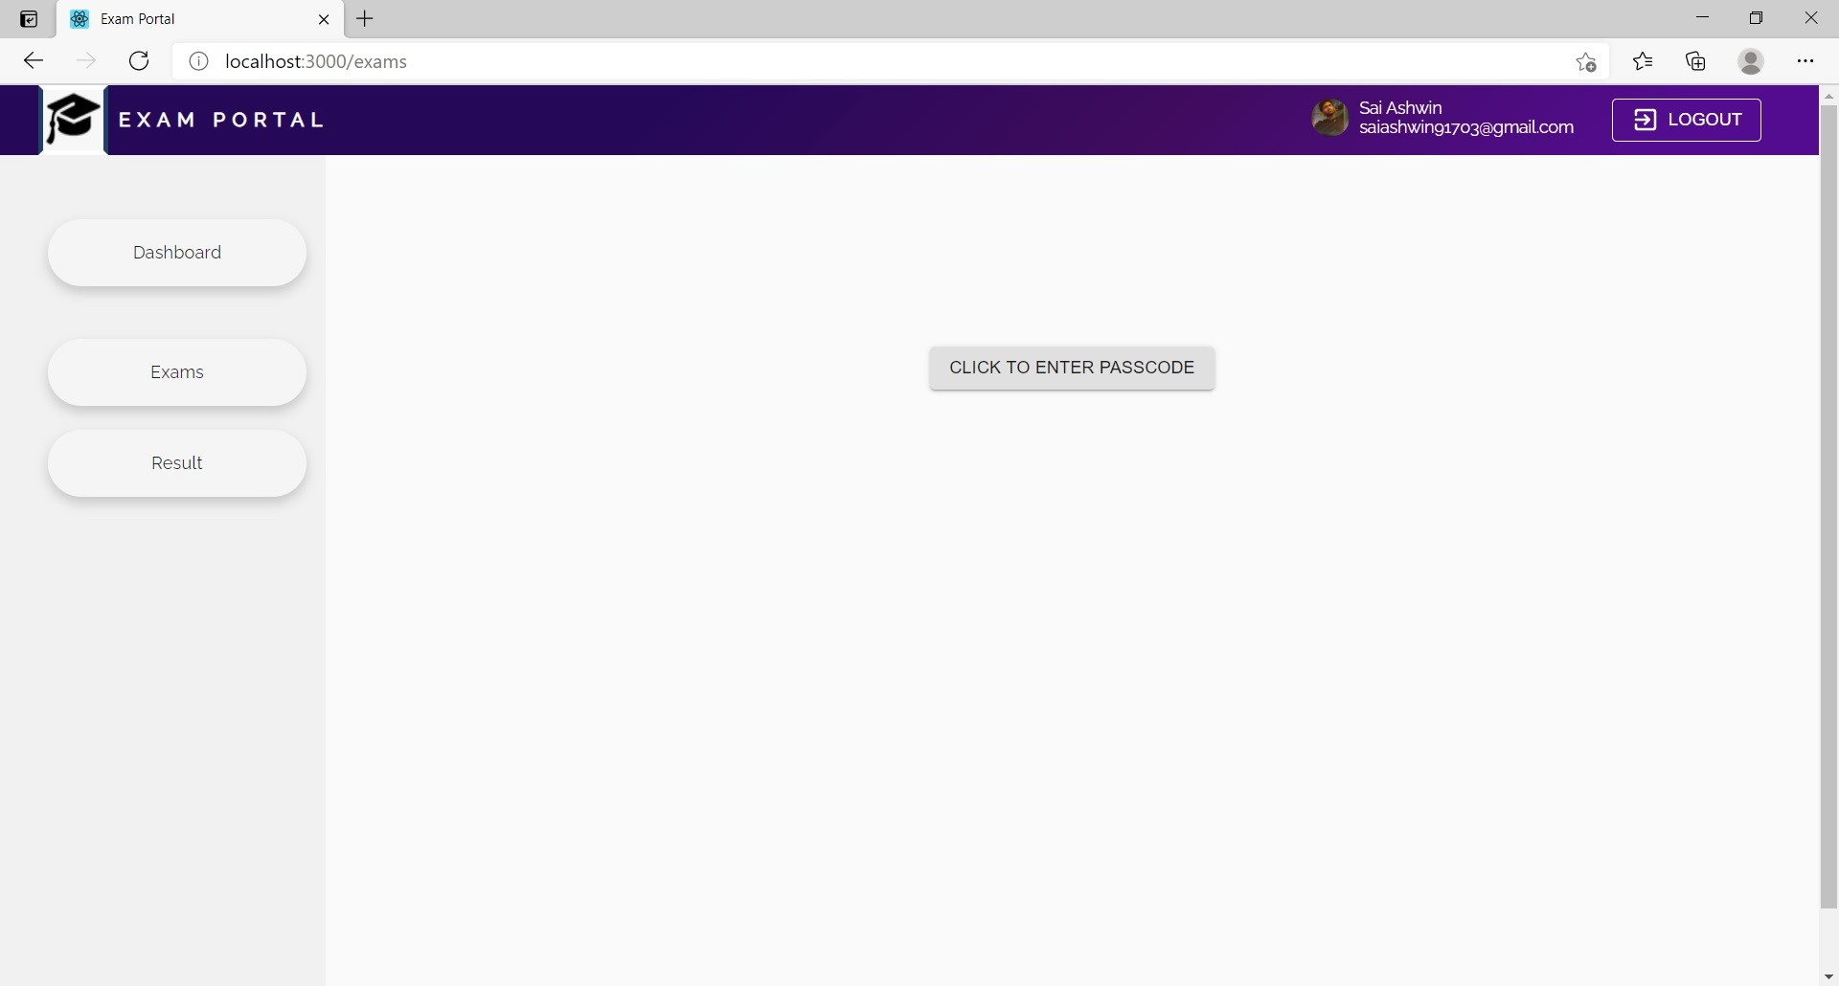

Slide 14
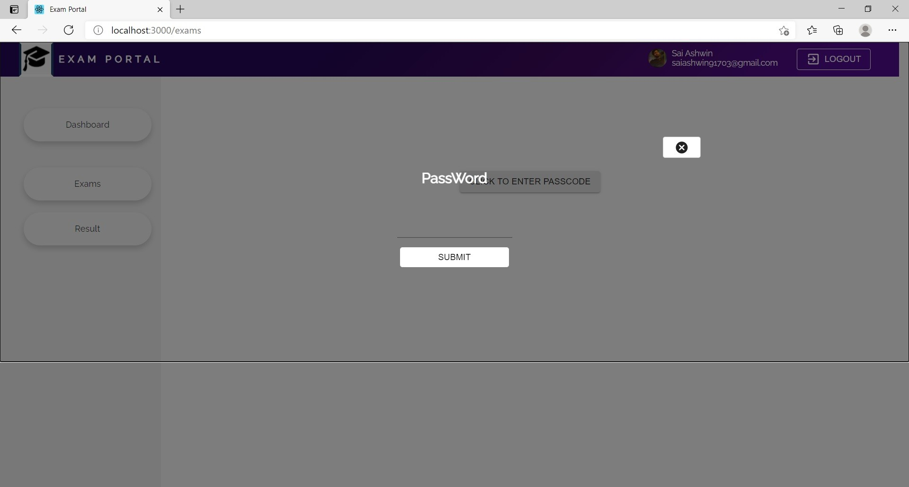
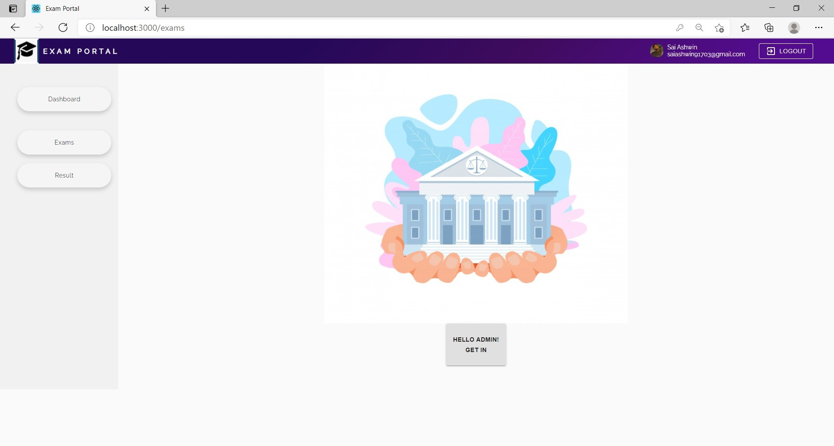
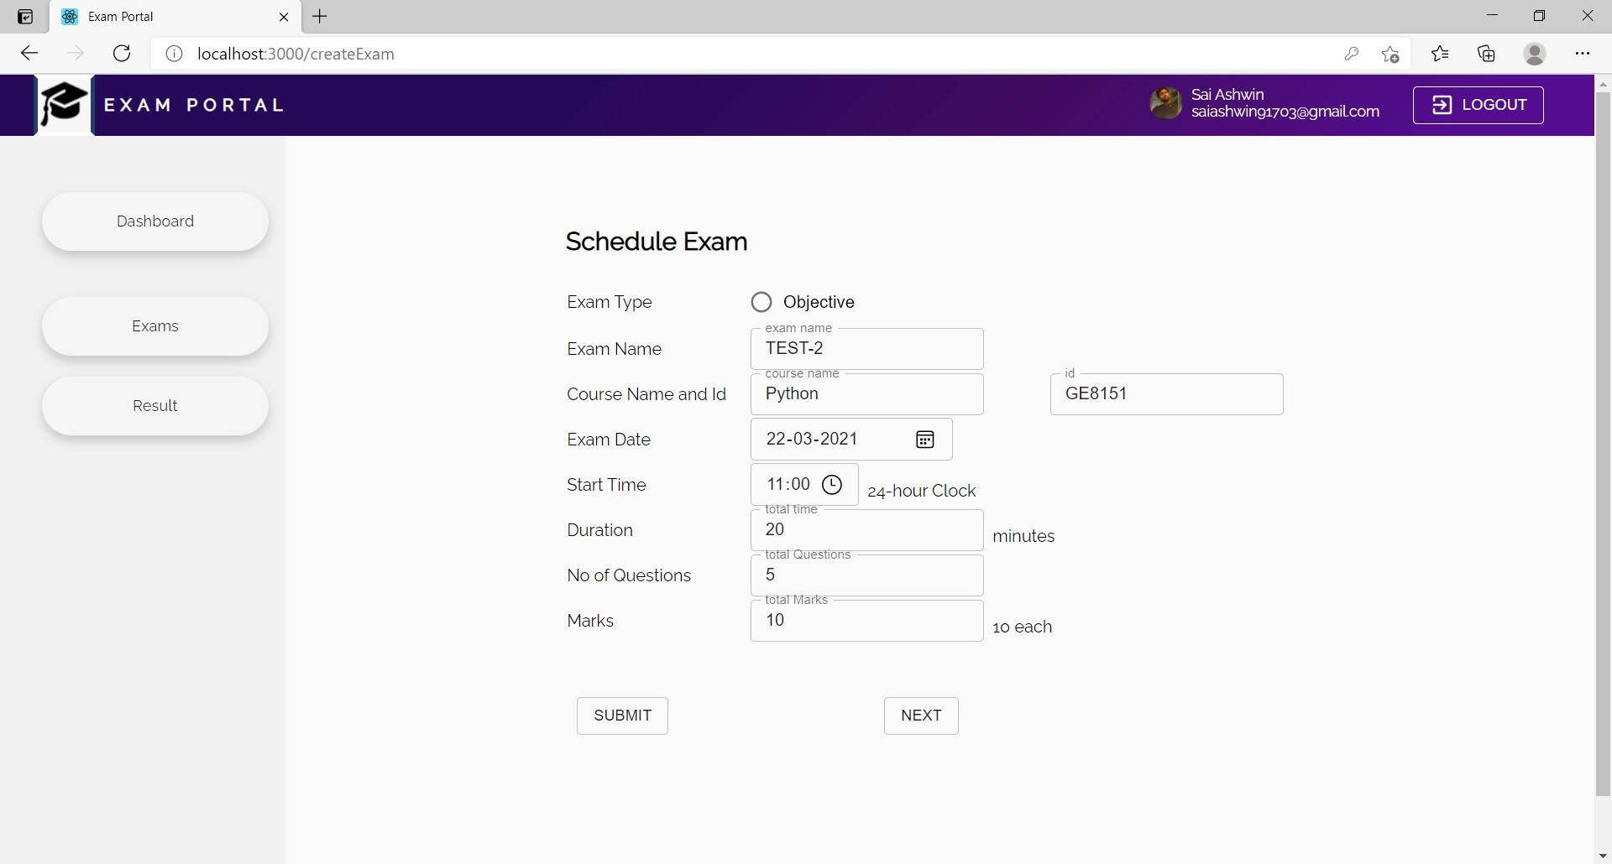
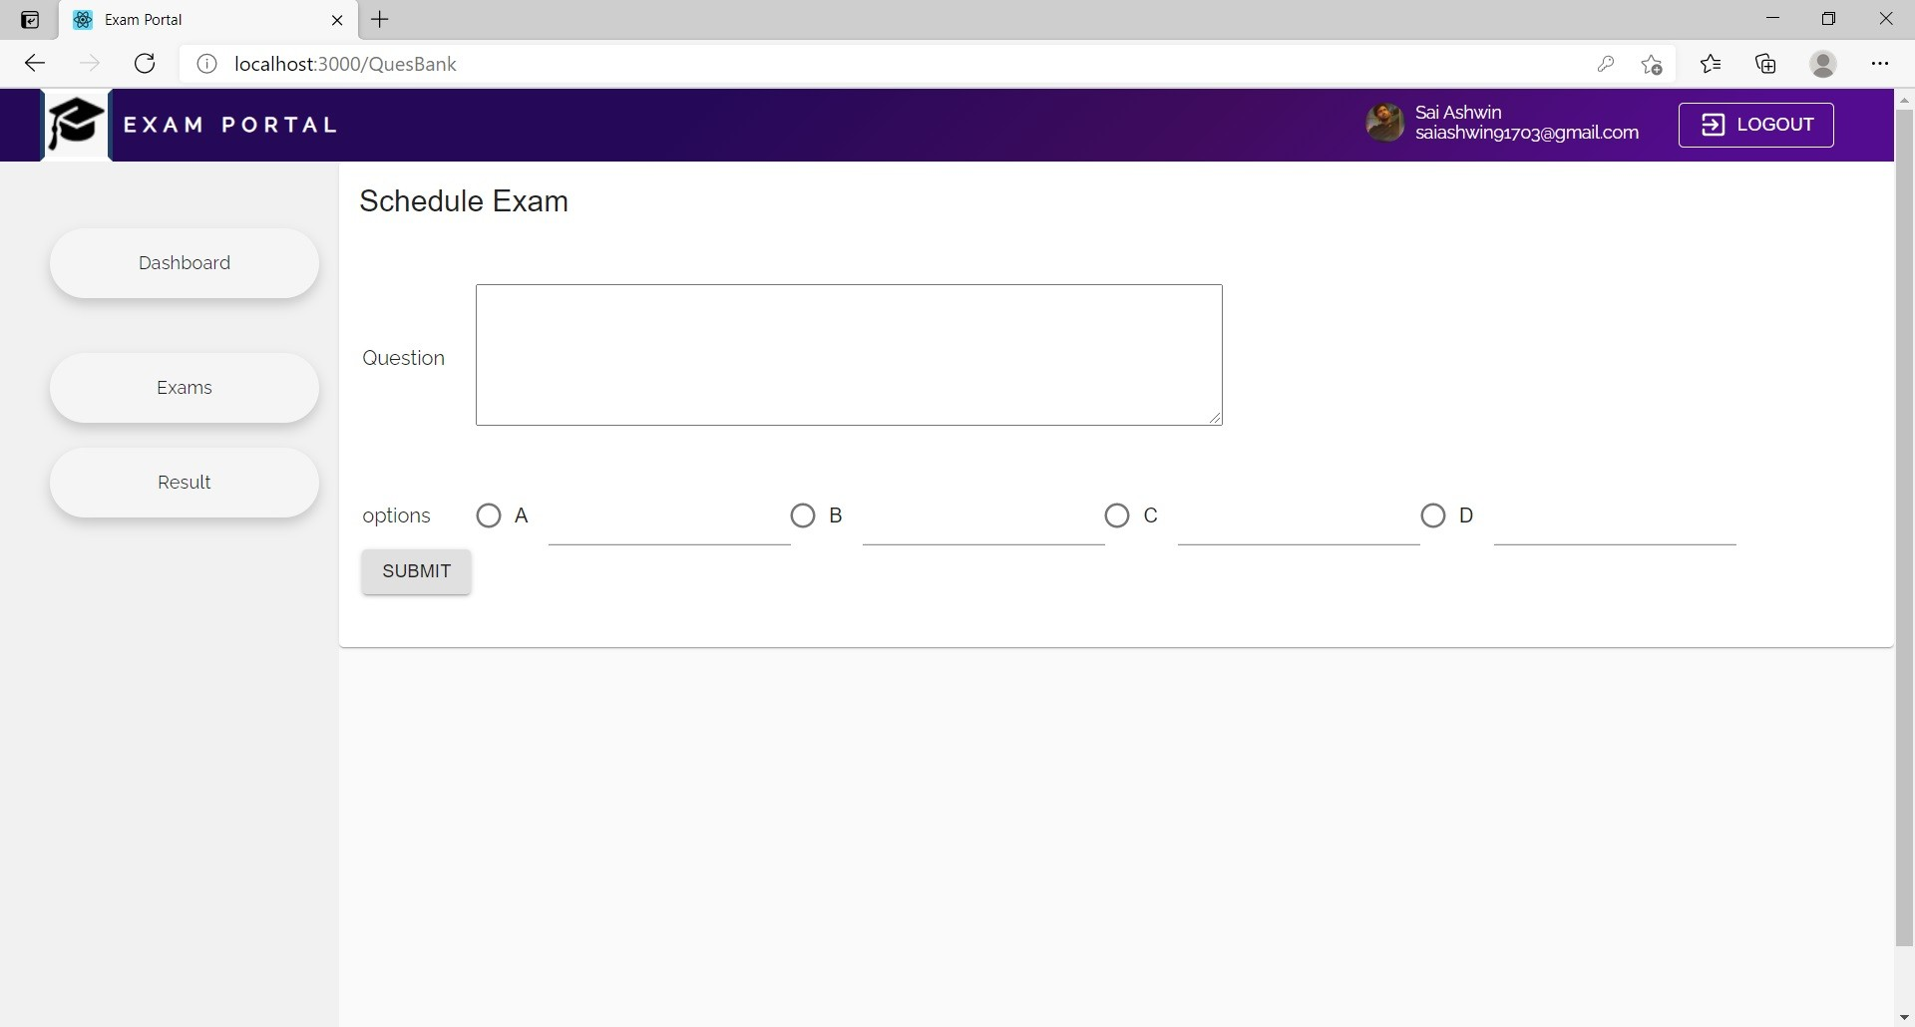

Slide 15
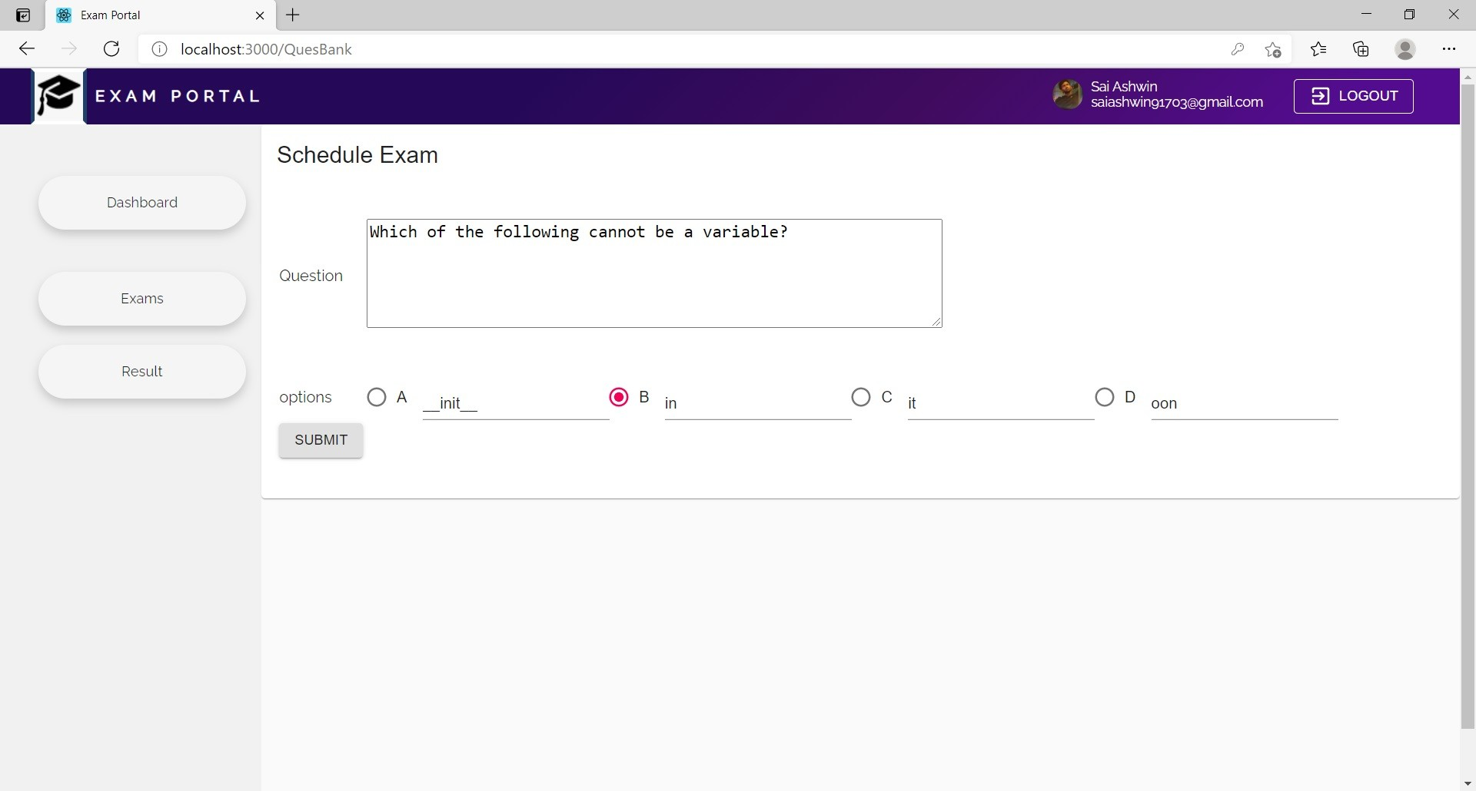
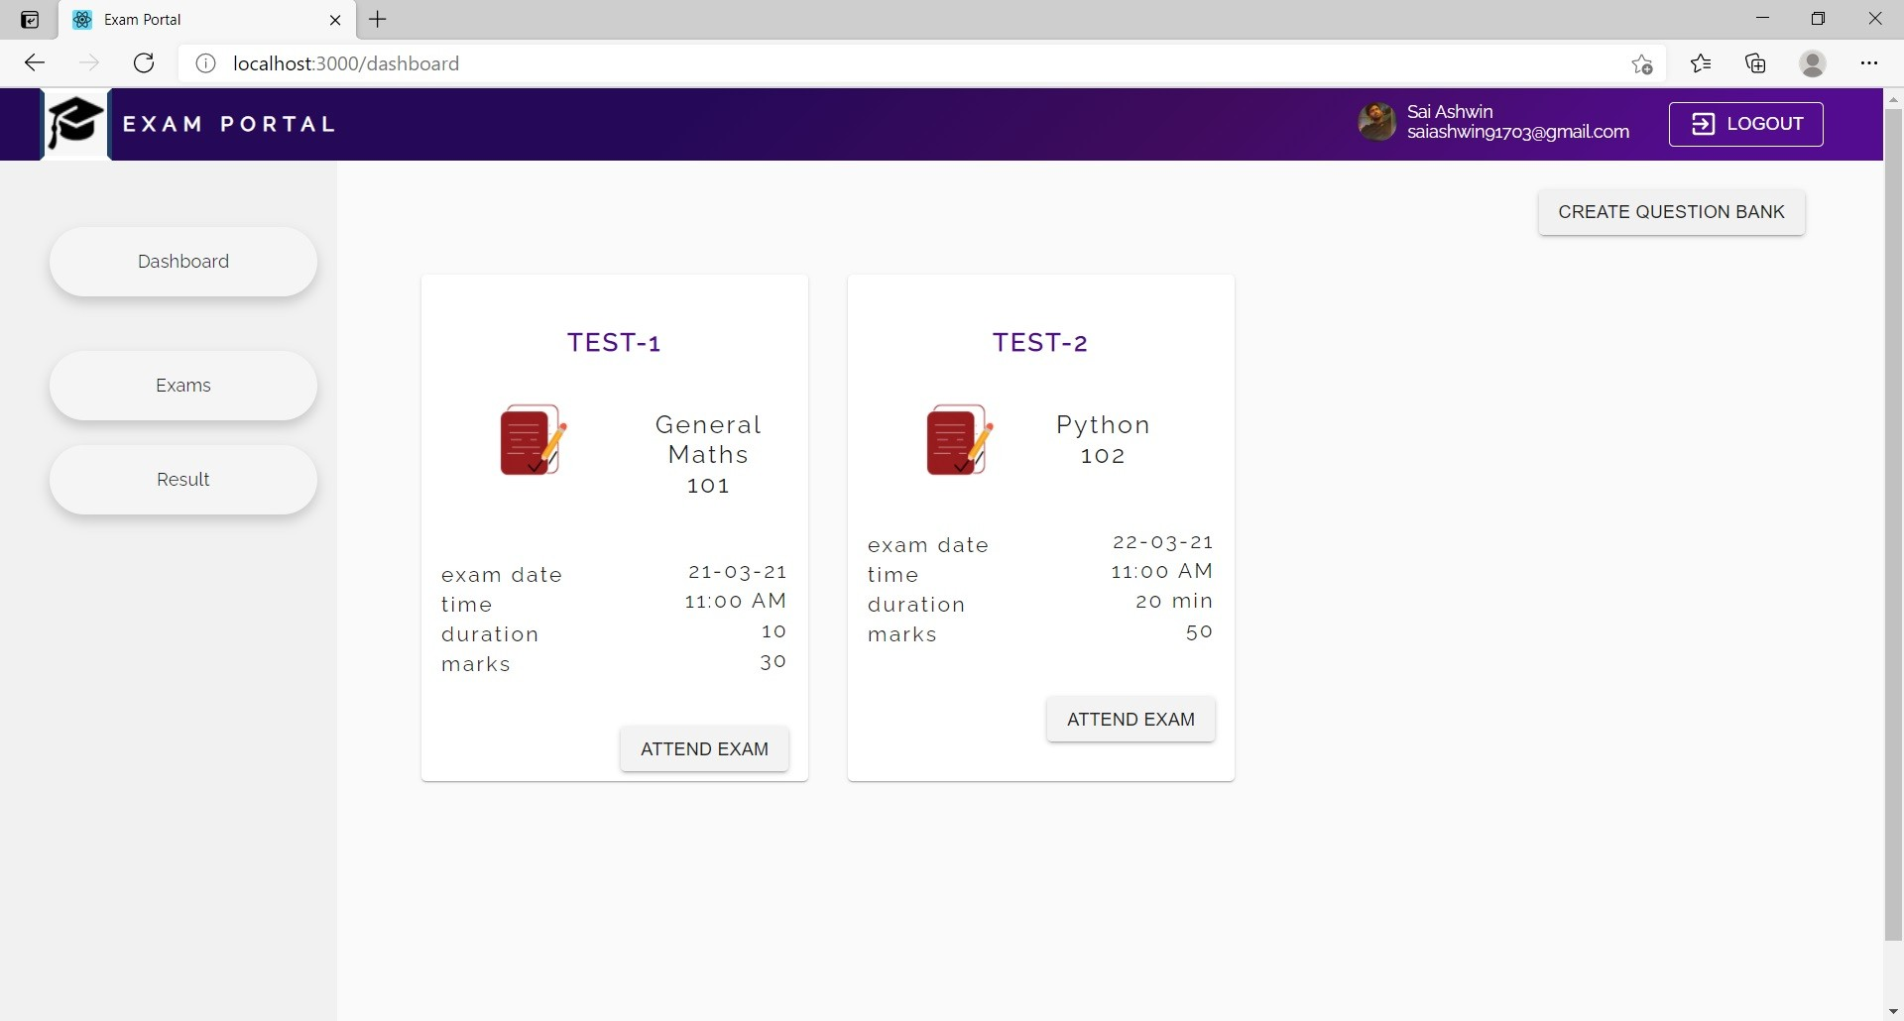
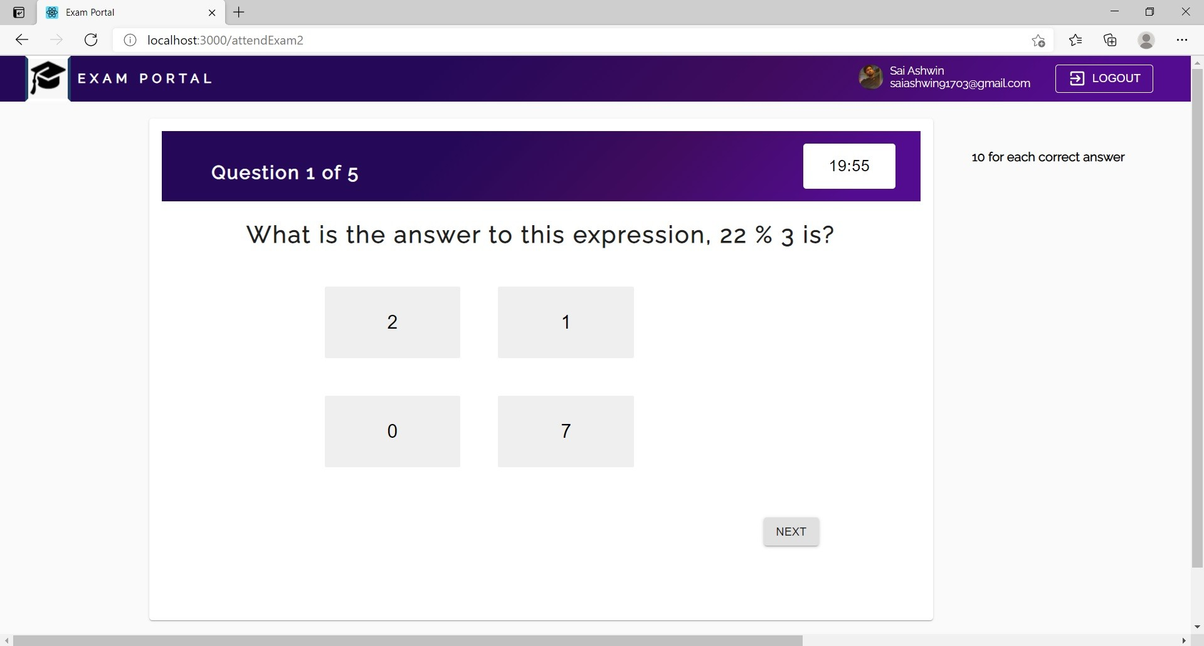

Slide 16
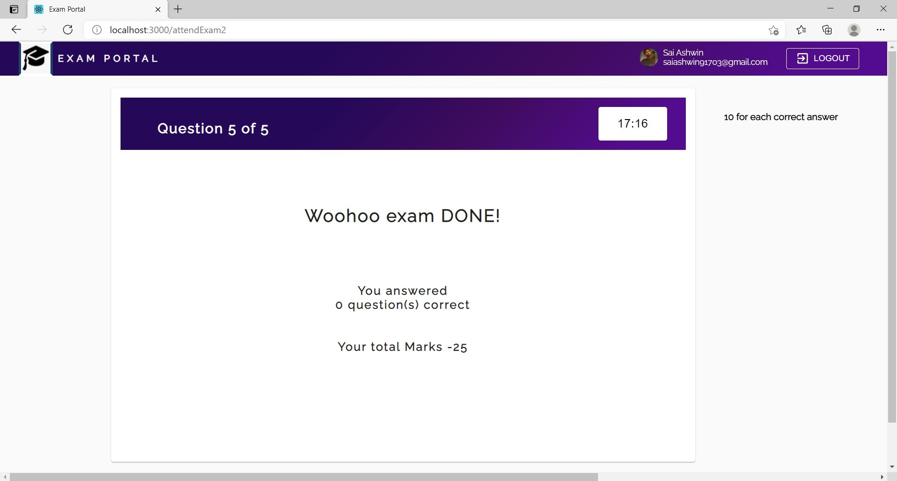
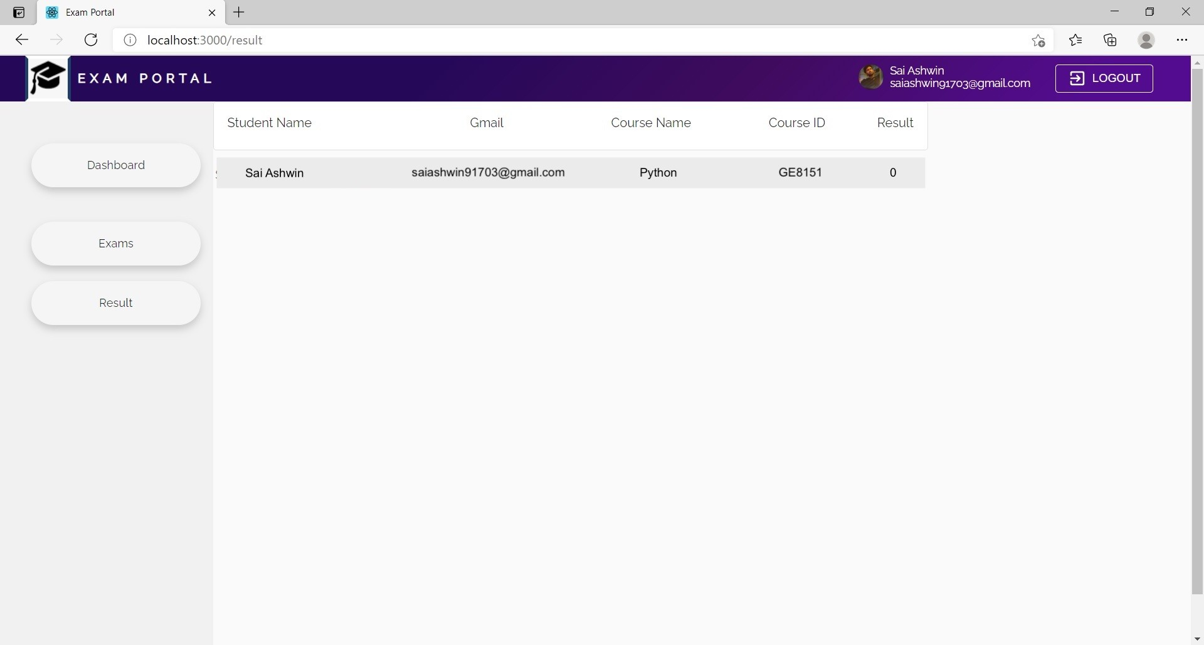

Slide 17
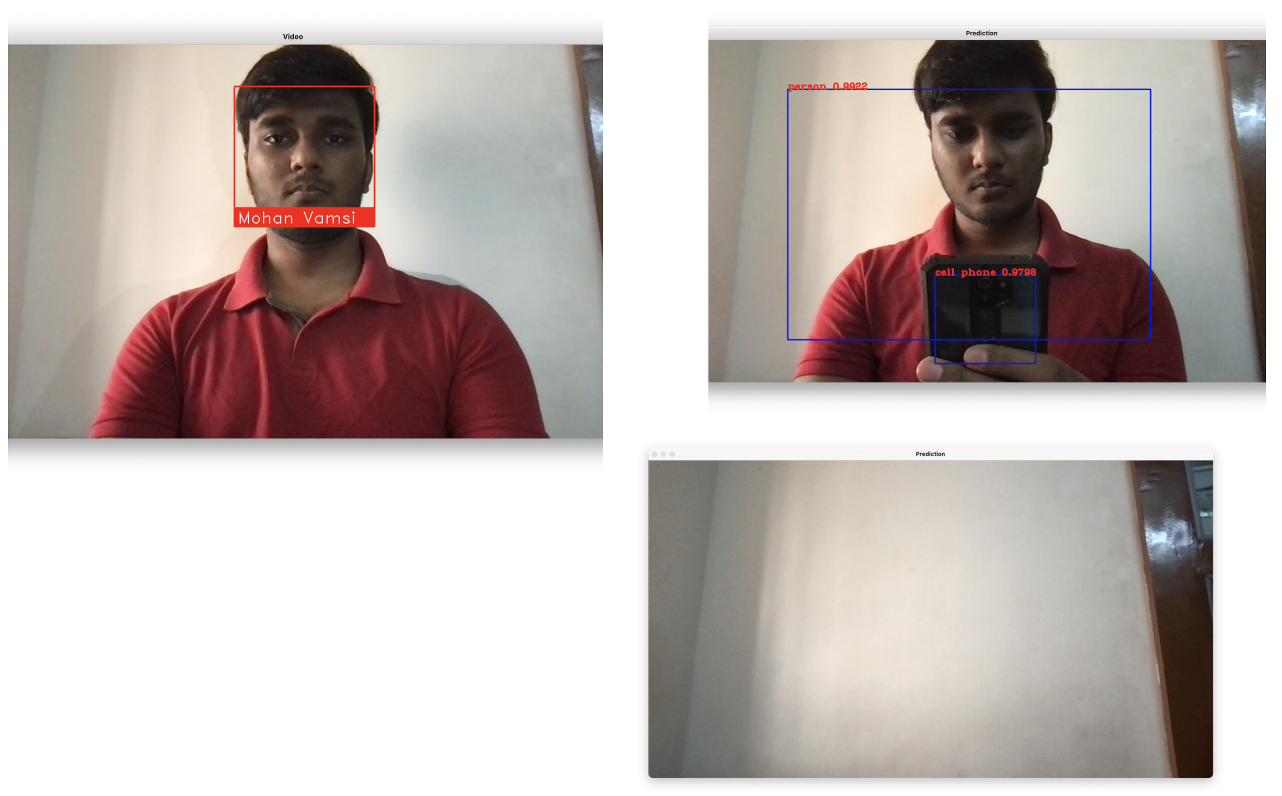
Person & Phone Detection

Slide 18
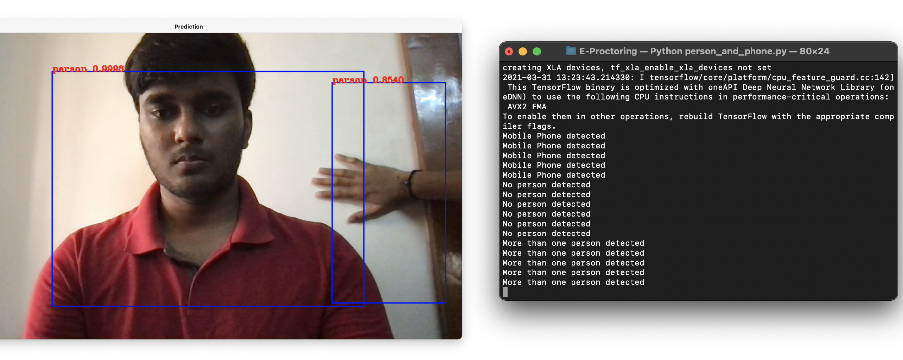
Multiple Person Detection

Slide 19
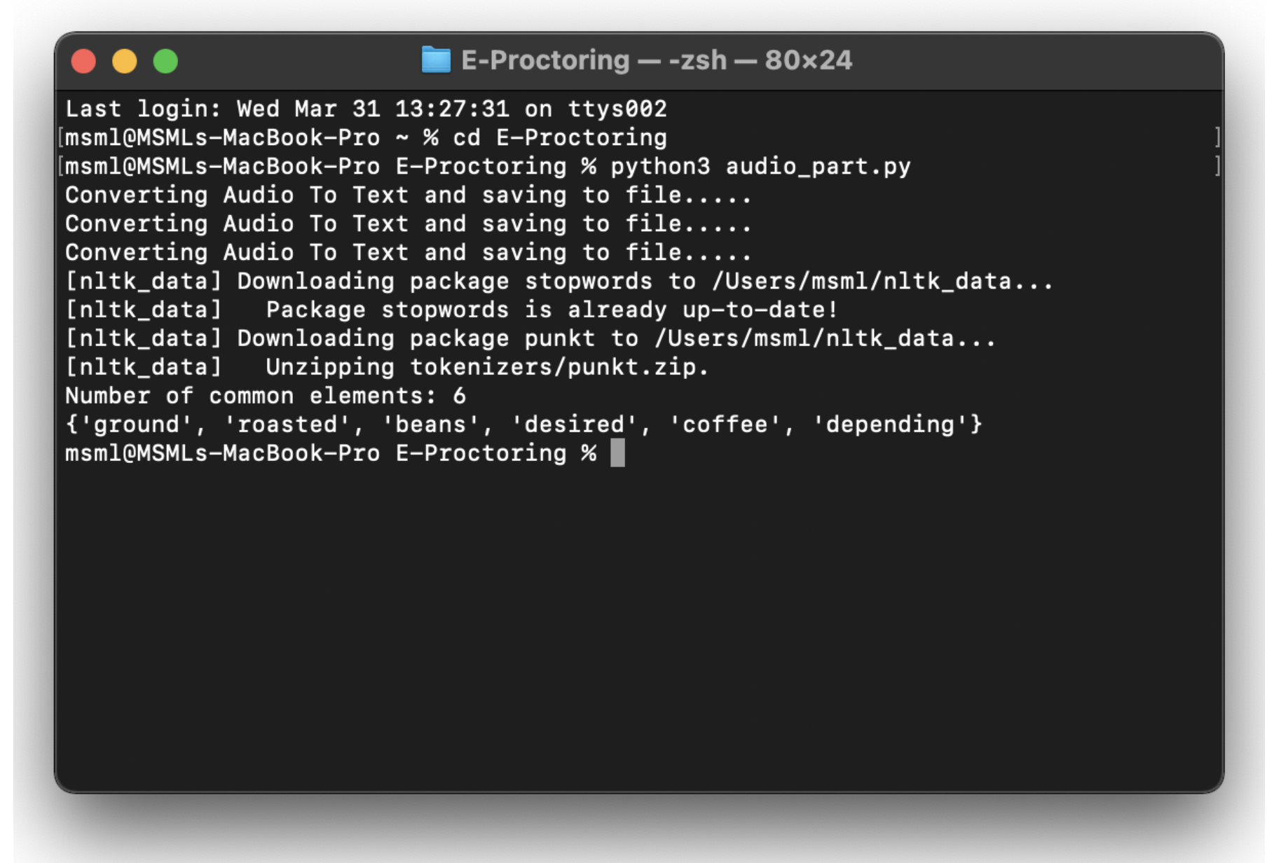
Audio Processing

Slide 20
Benefits
Candidates
The candidates enjoy more ﬂexibility about where an exam takes place
Exams can take place at home or in an office– which the candidate may feel more comfortable
Time convenience means they don’t have to take time oﬀ work to travel to the test location
Added privacy by sitting exams at home
Organization
It removes administrative burden. It removes the need of in-person invigilators and test centres, saves time and costs.
Not needing to book a speciflc space means exams can take place more frequently.
Exams can be scaled up worldwide
Security increases as invigilation becomes more one-to-one, any cheating would become more obvious and any evidence would be recorded.

Slide 21
Conclusion
Thus, the aim is to provide a safe and user-friendly environment to take exams from a remote location with a better machine learning model to proctor the examination and to prevent students from malpractices.
By combining the continuous estimation components, and applying a temporal sliding window, we design higher-level features to classify whether the test taker is cheating at any moment during the exam.

Slide 22
Thank you

